Slide 1
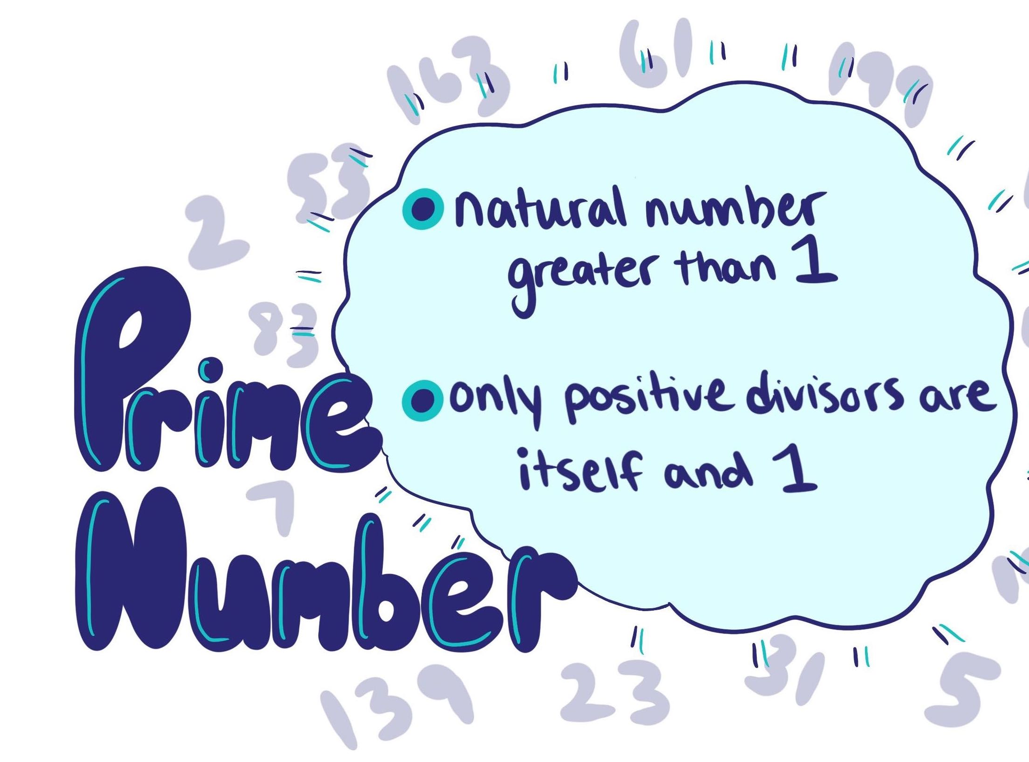
2025
Project Presentation
Prime
Numbers
By
Matsimbo Fotsing Cecile Darelle,
Tsiegoum Mouafo Naomi Ghislaine,
Dongmo Kingni Diffo Vianey and
Leuwaing Forsuh Henschel

Slide 2
Table of content
1
Introduction
4
Task 4
Prime numbers & RSA Crytosystem
Prime numbers theorem
2
Task 2
5
Task 5
Two prime number-related functions
Largest prime factor
3
Task 3
6
Conclusion
List of prime numbers
Thank you for your Attention

Slide 3
Introduction
5
4
3
2
1

Slide 4
Prime numbers and RSA crytosystem
RSA crytosystem
RSA (Rivest-Shamir-Adleman) cryptosystem is a public-key cryptosystem
It enables secure digital communication.
Introduction
It comes from the surnames of „Ron Rivest“, „Adi Shamir“ and „Leanard Adleman“
5
4
It was published in the year 1977.
3
Prime numbers
It‘s a number greater then 1.
2
It has only two factors: 1 and itself
1

Slide 5
Why are Prime numbers important in RSA?
Unique mathematical properties → Prime number are fundamental to the security of RSA system.
Interger factorization
Random number generation
Introduction
Unique mathematical properties → enable the creation of hard mathematical problems
5
Discrete Logarithm Problems
4
Hard mathematical problems → enable the creation algorithms
3
2
Resist attacks
Ensures confidentiality & integrity of sensitive information
1

Slide 6


How does it work?
Several key concepts
1. Trap door
Fundamental to public and private-key encryption
Ensures the safe sharing of public keys
Introduction
2. Generating
primes
Before encryption → receiver and sender exchange public keys
5
Keys generation → Primality test used (efficiently finds prime numbers)
Two selected prime numbers → very large and relatively far apart
4
For example: p and q →
3. Euler's totient function
Use ‚n‘ → λ(n) = (p-1)(q-1), where n=pq
3
e must be between 1 and λ(n)
2
RSA public key → chose a prime number e such that gcd(λ(n), e)=1.
4. Generating the public key
Use the extended euclidean algorithm to compute x, y: λ(n) · x + e · y = 1. We ignore x, but take the y: d = y mod λ(n) ∘ It follows that: e · d ≡ 1 mod λ(n)
1
Public key → encrypt plaintext m into Ciphertext c
c = mᵉ mod n
Private key → decrypt cyphertext c into Plaintext c
m = (mᵉ)^{d} mod n

Slide 7
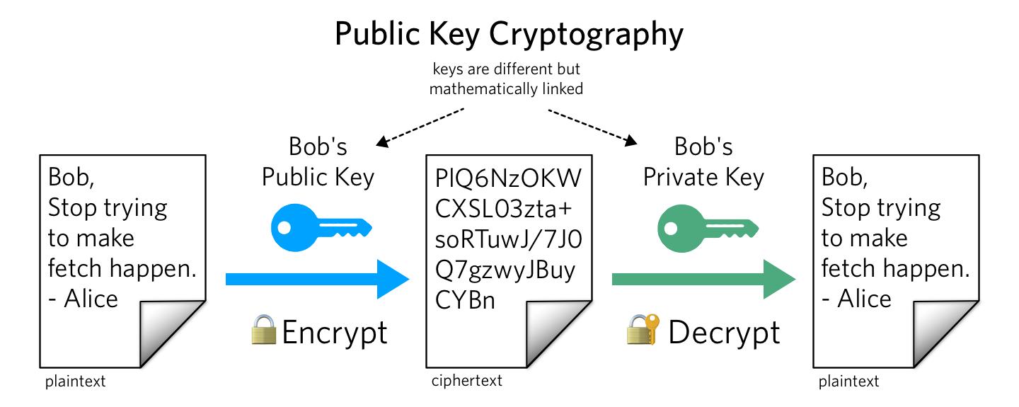
Application
Secure data transmission
SSL / TLS protocols in websites
Authentication in secure systems
Digital Signature
Introduction
5
4
3
2
1

Slide 8
Task 2
Prime
Numbers
Prime Numbers-Related Functions
a) Overall Goal
Implement two custom functions related to prime numbers.
Use basic programming constructs :
Arithmetic operations: +, -, *, /, mod
Control Structures: if/else, for, while
Two codes:
Less Efficient
More Efficient

Slide 9
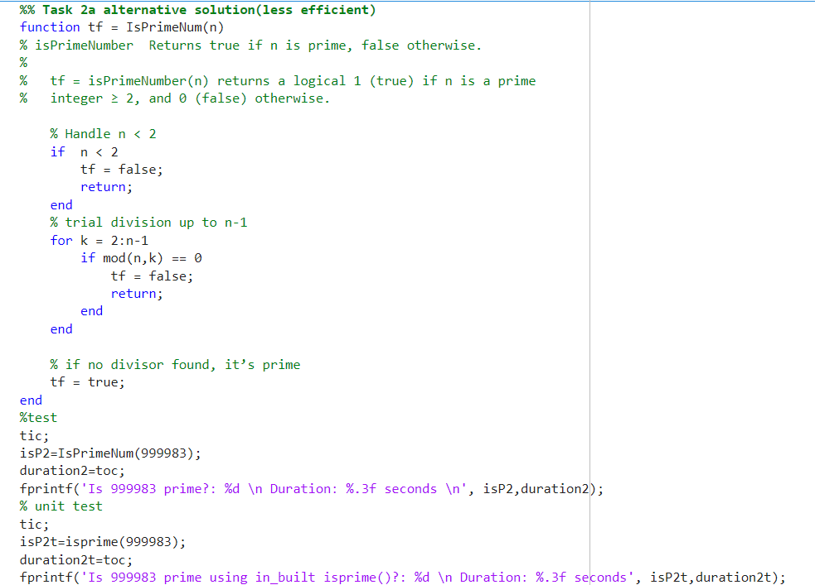

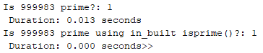
Task 2
Prime Numbers-Related Functions
a) Overall Goal
Functionality: checks if a given number prime
Input: A single natural number n
Output: Boolean (true(1) if prime, false(0) otherwise)
Logic:
Check divisibility from 2 to n-1
If divisible by any other number than itself
→ It‘s not Prime.
Less Efficient: time consuming

Slide 10
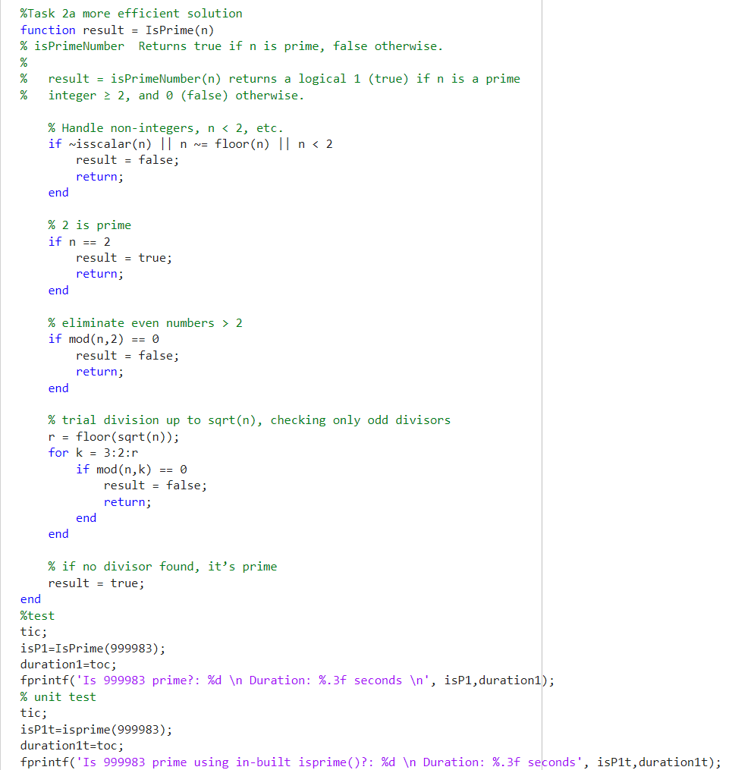
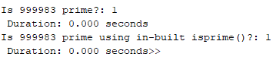

Task 2
Prime Numbers-Related Functions
a) Overall Goal
Functionality: checks if a given number prime
Input: A single natural number n
Output: Boolean (true(1) if prime, false(0) otherwise)
Logic:
Make sure n is not less than 2
Directly handle case n==2 and also eliminate evnem numbers
Check divisibility from 2 < n >= sqrt(n)
If divisible by any number than itself
→ It‘s not Prime.
More Efficient: Time saving

Slide 11
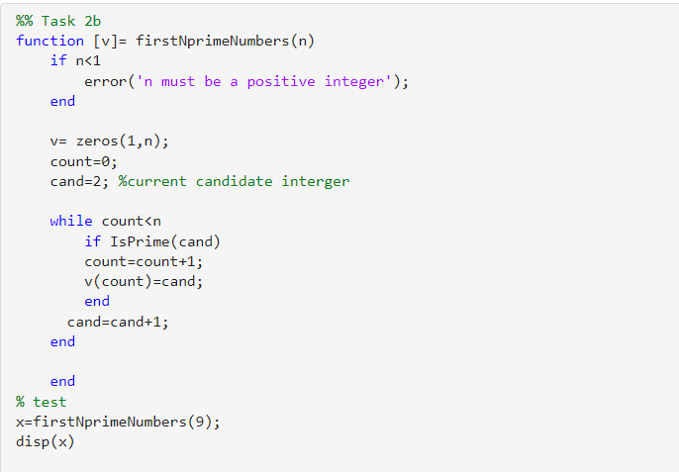
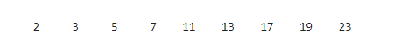
Task 2
Prime Numbers-Related Functions
b) Overall Goal
Functionality: Returns a vector of the first n prime numbers
Input: A number n (how many primes to find)
Output: A vector of primes
Logic:
Initialise a vector of size n filled of zeros
For each cand >= 2 check using „a“ if it's prime
Add to result vector v if prime.
Count is initialised to 0 and runs till n-1 ensuring we get the first n primes only

Slide 12
Task 3
List of Prime Numbers
List of Prime Numbers
Overall Goal
Use previously written codes to:
Brute-force
Simple and straightforward problem-solving approach
Identify specific Primes in a sequence.
Calculate the sum of given primes
Handle both small- and large scale prime computations
Less Efficient: time consuming
Explore optimization strategies if brute-force is slow

Slide 13
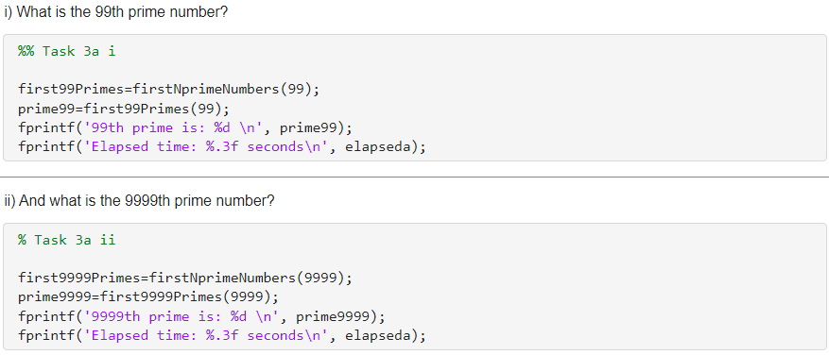
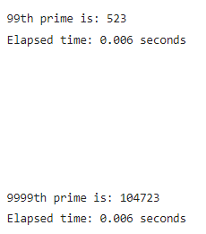
Task 3
List of Prime Numbers
a) Finding specific prime numbers
Logic:
Start from 2, check each number for primality
Stops when the number is found
Two cases:
99
9999

Slide 14
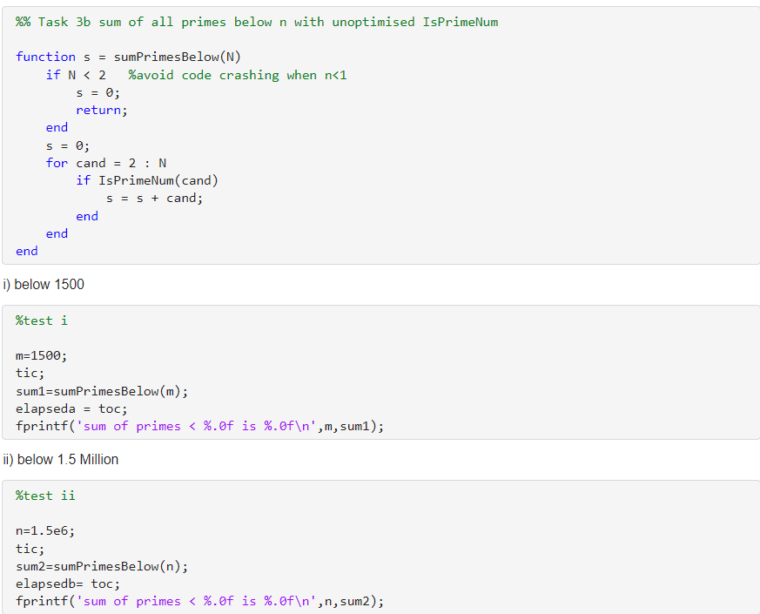
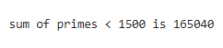
Task 3
List of Prime Numbers
b) Sum of all Primes below a given limit
Function: sumPrimesBelow(N)
Input: take a number N
Output: sum all primes below N
Logic
Loop through numbers from 2 to n-1 ("unoptimised IsPrimeNum()")
Check condition
If Prime, add to a cumulative sum
Less Efficient: time consuming
No output

Slide 15
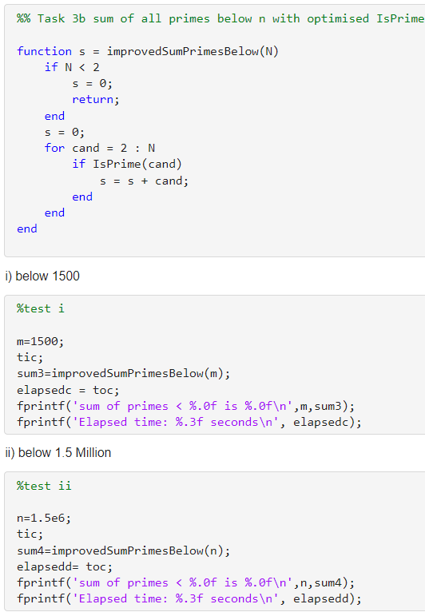
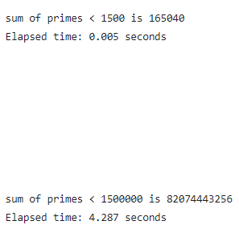
Task 3
List of Prime Numbers
b) Sum of all Primes below a given limit
Function: improvedSumPrimesBelow(N)
Uses the optimise "IsPrime"
Implementation of efficient root checking
Even number skipping
Same Output but
Faster execution
Suitable for larger input values
More Efficient: Time saving

Slide 16
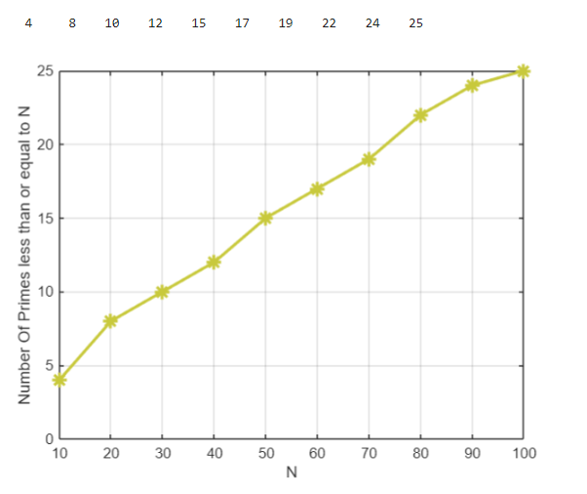
Task 4
Title: graph of pi(v) againt N
Prime Numbers Theorem
a) Prime-Counting Function pi(x)
Goal:
Prime-counting factor pi(x)
Prime less than or equal to x
Function: pi(v)
Loop from 2 to v
Use IsPrimeNum(i) to check primality and count the number of primes
X-label: (‚N‘) → N
Y-label: (‚Number Of Primes less than or equal to N‘) → pi(v)

Slide 17
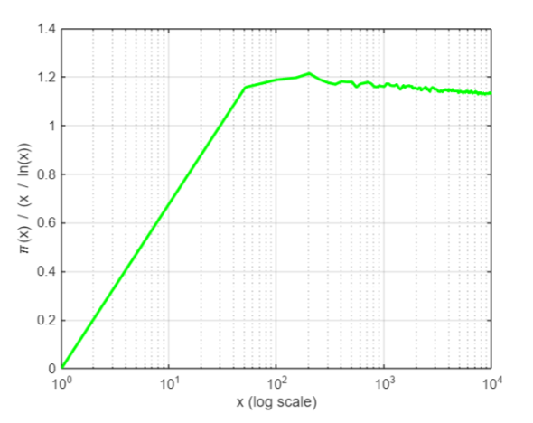
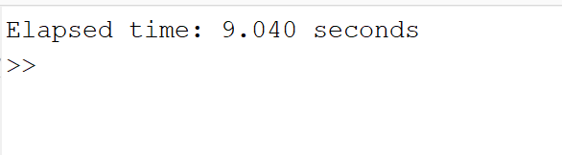
Function: A graph of pi(x)/(x/ln(x)) against x
Task 4
Prime Numbers Theorem
b) Plot the ratio π(x)/ x ln x
Goal:
To observe how the ratio pi(x)/(x/ln(x)) approaches 1 as the value increase. This visualization is used to support the prime number theorem.
Here we used linear space x-values.
Less Efficient: time consuming

Slide 18
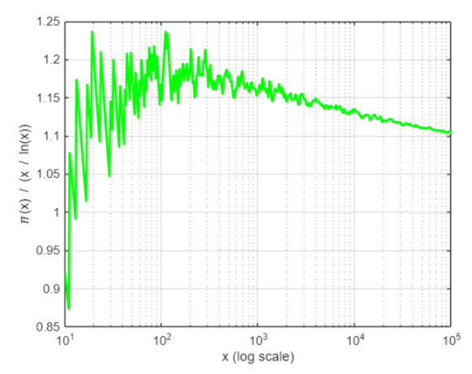
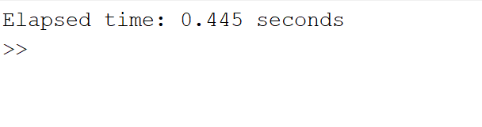
Task 4
Function: A graph of pi(x)/(x/ln(x)) against x
b) Plot the ratio π(x)/ x ln x
Goal: ​
To observe how the ratio pi(x)/(x/ln(x)) approaches 1 as the value increase. This visualization is used to support the prime number theorem.
Here we used logarithmic spacing.
Here we have a
Faster execution
More Efficient: Time saving

Slide 19
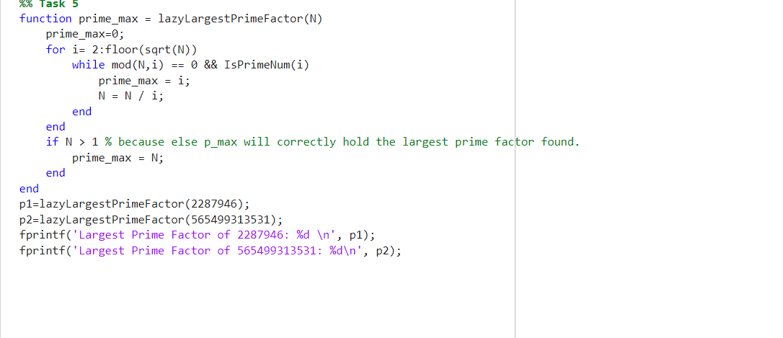
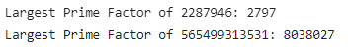
Task 5
Overall goal:
Find the largest prime factor of a given number N.
Two numbers were tested
Small: 2,287,946 → test 1
Large: 565,499,313,531 → test 2
Logic:
Checks only from 2 to sqr(N)
Skipping even numbers after 2
Checking for primality before storing the factor

Slide 20

Thank you

